Slide 1
NODE.JS
(The Backend Of MERN Stack)
Lecture 29

Slide 2
Today’s Agenda
About MongoDB
History Of MongoDB
Understanding Collections & Documents
BSON
BSON V/s JSON
Installing MongoDB
Testing The Installation

Slide 3
About mongodb
MongoDB is an open source, document oriented database that stores data in form of documents (key and value pairs).
A document based database is one of the types of NoSQL database.

Slide 4
History of mongodb
MongoDB was created by Eliot and Dwight (founders of DoubleClick) in 2007 when they faced scalability issues while working with relational database.
The organization that developed MongoDB was originally known as 10gen.

Slide 5
History of mongodb
In Feb 2009, they released MongoDB as an open source Project.
Finally, the organization changed its name in 2013 and now known as MongoDB Inc.

Slide 6
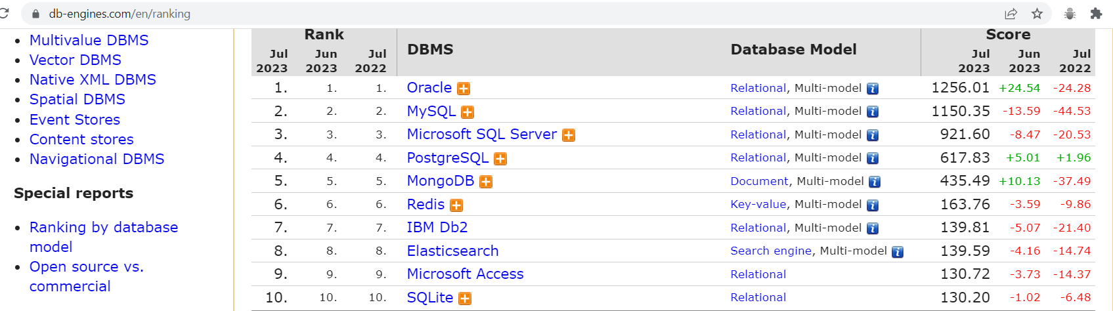
Current status
As of now MongoDB is the fifth most popular database.
Source :https://db-engines.com/en/ranking

Slide 7
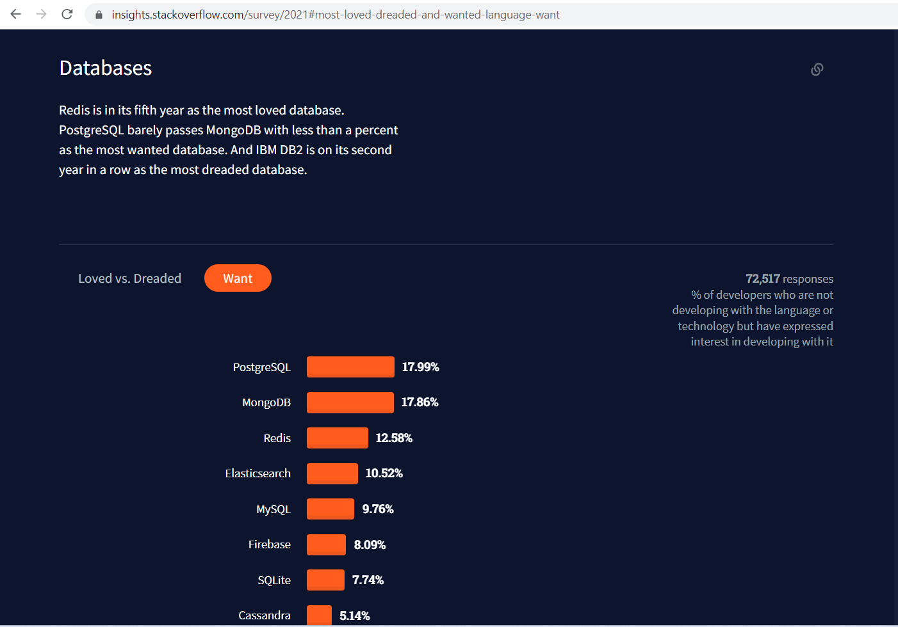
Current status
It also consistently ranks as one the most wanted databases year after year, meaning developers want to learn it more than any other database.
Source : https://insights.stackoverflow.com/survey/2021#most-loved-dreaded-and-wanted-language-want

Slide 8
mongodb basics
Before we install and start interacting with MongoDB it is important to understand 4 technical terms in MongoDB .
These 4 terms are:
Database
Collections
Documents
BSON

Slide 9
mongodb basics
Data in MongoDB is made up of three types of components: databases, collections, and documents.
The database sits at the top of the hierarchy, collections at the next level, and documents at the bottom.

Slide 10
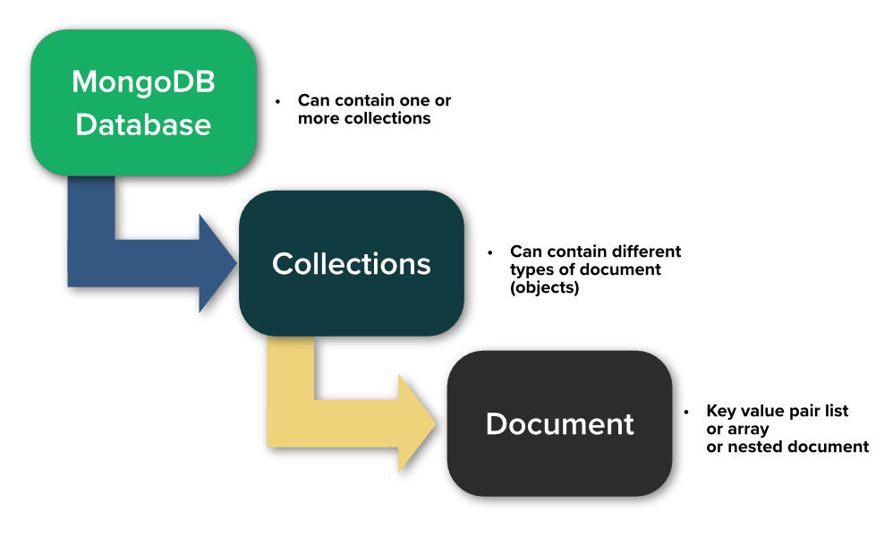
mongodb basics
A database provides a container for storing and organizing data.
Each database contains one or more collections, and each collection contains zero or more documents.

Slide 11
Understanding mongodb documents
The document, which is comprised of field/value pairs, is at the heart of the MongoDB data structure.
Most interactions with MongoDB occur at the document level.

Slide 12
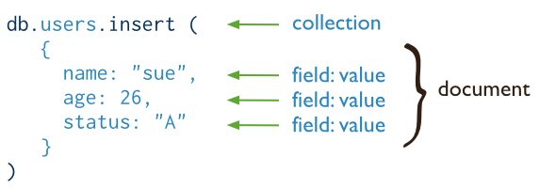
Understanding mongodb documents
A field can contain a single value, multiple fields, or multiple elements.

Slide 13
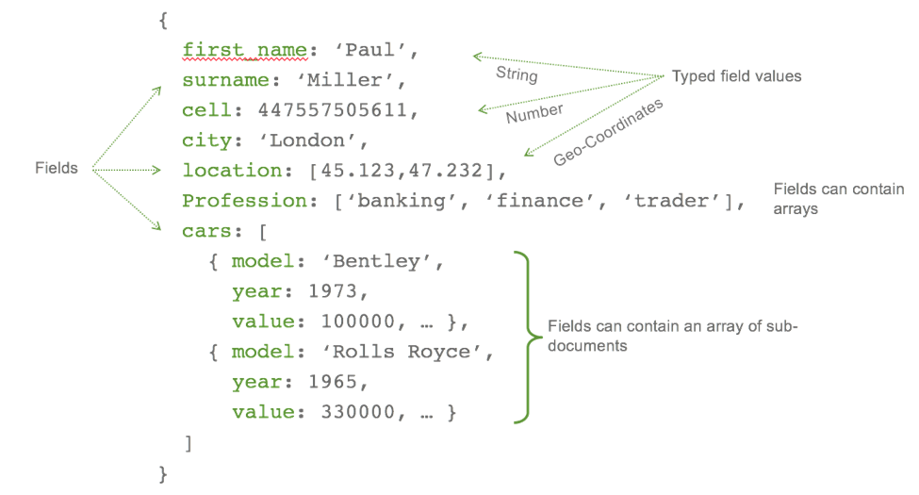
Documents with array
A value made up of multiple elements is referred to as an array and is assigned the Array data type.

Slide 14
Embedded documents
A value made up of multiple fields is referred to as an embedded document and is assigned the Object data type .

Slide 15
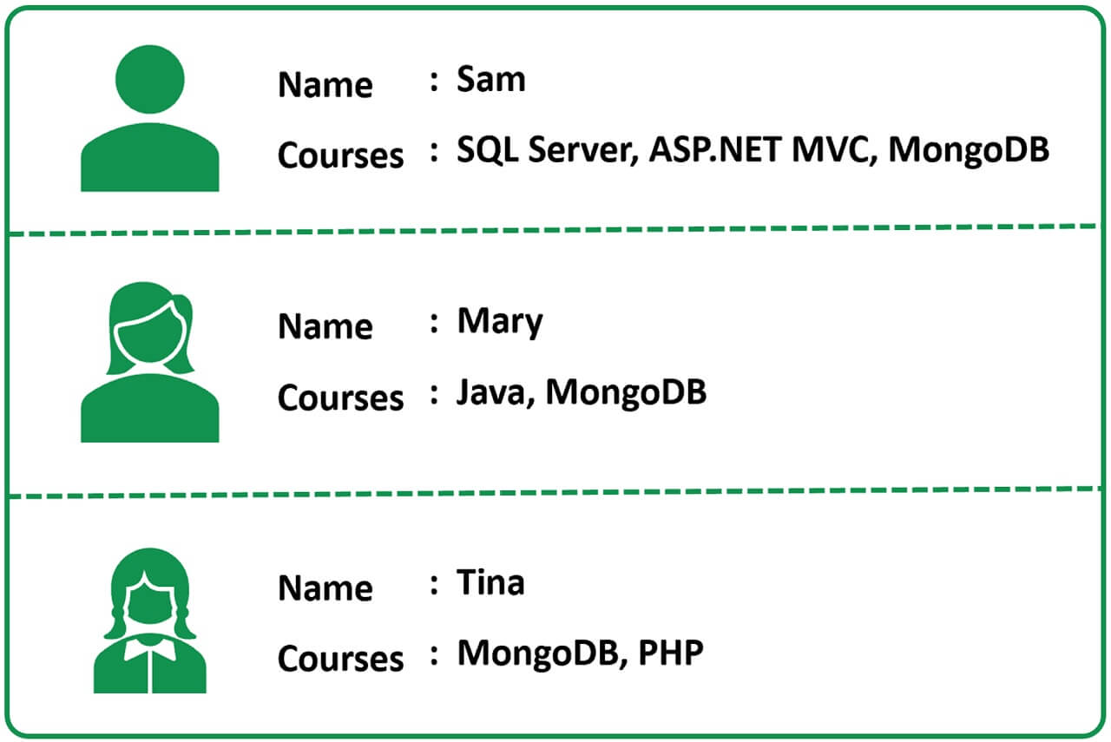
A real world use case
Suppose we are developing an application for a training institute and we have a page that displays student names and the courses that they have enrolled in, as shown below:

Slide 16
how mysql will represent this ?
To model this use-case, in a relational database world like MySQL or Oracle, we typically create 3 tables:
Students - Stores the details of students like Id and Name.
Courses - Stores the course details like course Id and Name.
StudentCourses - Storing Student Id and Course Id taken by each Student.

Slide 17
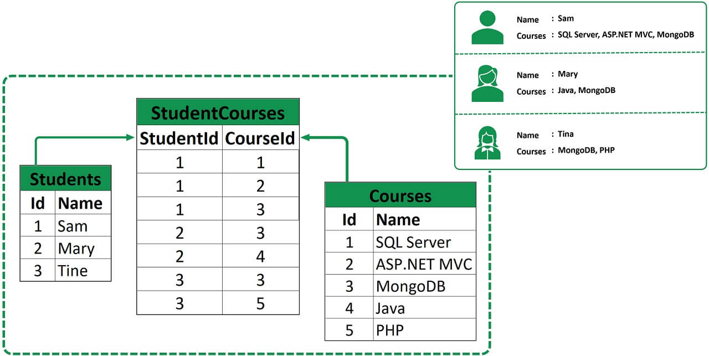
how mysql will represent this ?

Slide 18
how mongo will represent this ?
Now, let's see how this same data may be stored in MongoDB.
As we have already discussed, in Mongo we do not have tables and rows, instead we have collections and documents.

Slide 19
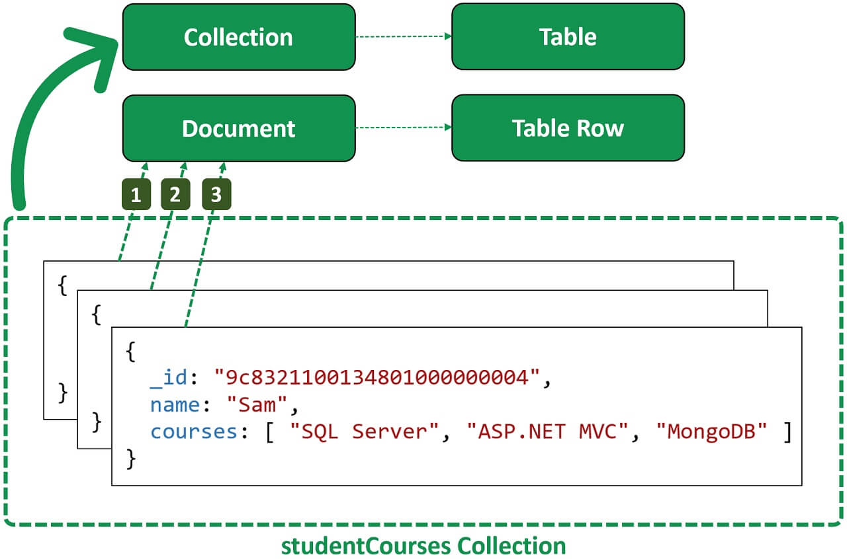
how mongo will represent this ?

Slide 20
how mongo will represent this ?
In this example:
We have 1 collection called studentCourses containing 3 documents.
So, just like a table is a container for rows, a collection is a container for documents which hold the actual data.
This data is in BSON format so the documents are also called BSON documents.

Slide 21
benefit
The same students and courses data that we have across 3 tables in a relational database can be stored in a single collection in Mongo.
For an application this data is very easy to work with.
No complex joins and mapping layers are required and so our application code will be much cleaner, simpler and easier to maintain.

Slide 22
bson
MongoDB stores data in BSON format internally on the disk.
But that doesn’t mean we can’t think of MongoDB as a JSON database.
Anything we can represent in JSON can be natively stored in MongoDB, and retrieved just as easily in JSON.

Slide 23
bson
Moreover in our code we can use the data types provided by our language and the MongoDB package/driver will convert the data to BSON and back when querying the database.

Slide 24
Json v/s bson
JSON and BSON are indeed close cousins by design.
However the MongoDB team designed BSON as a binary representation of JSON data, with specific extensions for broader applications and optimized for data storage and traversal.

Slide 25
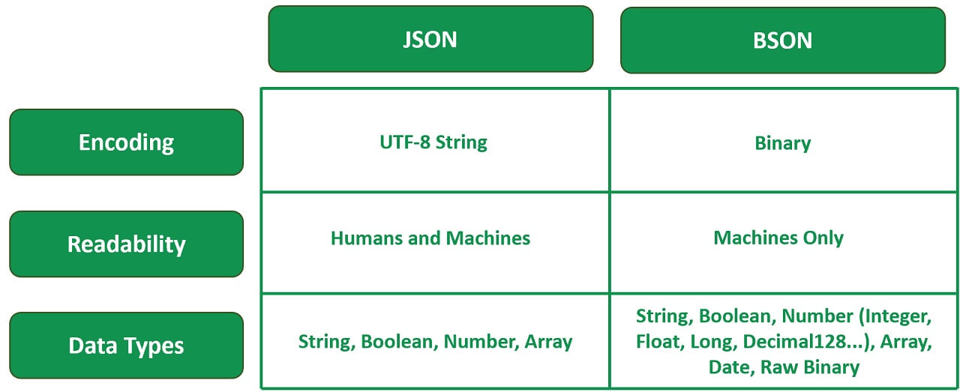
Json v/s bson

Slide 26
Working with Mongodb
There are 2 ways to work with MongoDB:
By using cloud service.
By installing on local machine.

Slide 27
cloud server
The cloud service of MongoDb is called Atlas.
It is a multi-cloud database service by the same people that build MongoDB.
Atlas is available on AWS , Azure as well as GCP and simplifies deploying and managing our databases .

Slide 28
Local installation
Local installation allows us to host our own MongoDB server on our computer.
This server is called MongoDB community Server and it requires us to manage our server, upgrades, and any other maintenance.
We will be using this approach in this course.

Slide 29
Installing mongodb Locally
Setting up MongoDB on Windows/Mac will consist of completing these two installations:
MongoDB Community Server Installation
MongoDB Shell Installation
Following is the link for windows:
https://www.mongodb.com/docs/manual/tutorial/install-mongodb-on-windows/
Following is the link for mac:
https://www.mongodb.com/docs/manual/tutorial/install-mongodb-on-os-x/

Slide 30
Components of local installation
When we install MongoDB locally we get 3 components:
MongoDB Community Server
MongoDB Shell
MongoDB Compass

Slide 31
mongoDB Community server
MongoDB Community Server is a free and open-source version of MongoDB.
It is designed for developers and small-scale deployments and offers dev rich and intuitive features for saving and querying data.

Slide 32
mongoDB shell
MongoDB Shell is an interactive JavaScript interface for querying and modifying database data.
We can also use it to perform administrative operations like creating databases, collections etc.

Slide 33
mongoDB compass
MongoDB Compass is a GUI (Graphical User Interface) for querying, visualizing and modifying database data.
Behind the scenes, both the Shell and Compass issues the same commands to the database server.

Slide 34
Using mongodb
Before we start using MongoDB following 3 steps must be taken:
Ensure that PATH to MongoDB bin folder is set.
Ensure that PATH to mongosh is set.
Ensure that two folders called data\db must exist in C:\drive

Slide 35
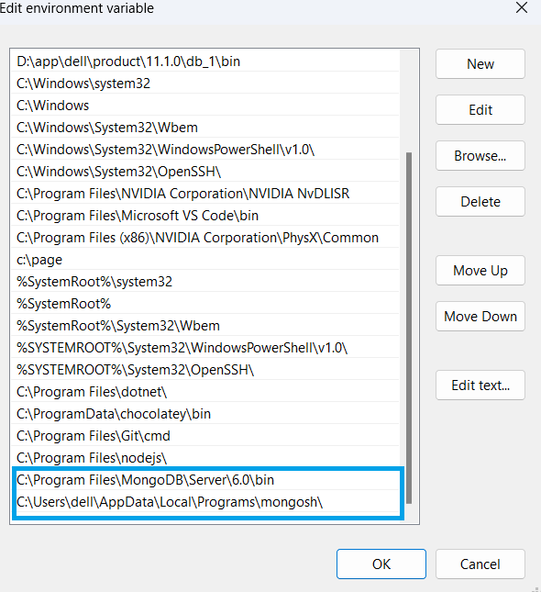
Path settings

Slide 36
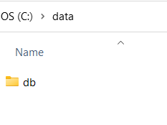
folders

Slide 37
Using mongodb
To interact with MongoDB we need to do 2 things:
Start the MongoDB server : This is done by executing the mogod command on the command prompt.
Open the Mongo Shell: This is done by executing the mongosh command on the command prompt.

Slide 38
What is mongod command ?
The mongod command stands for “Mongo Daemon”.
It is a background process used by MongoDB.
The main purpose of mongod is to manage all the MongoDB server tasks like:
accepting requests
responding to client and
memory management

Slide 39
What is mongsh command ?
The mongsh command stands for “Mongo Shell”.
It launches the MongoDB Shell which is the quickest way to connect, configure, query and work with our MongoDB database.
The MongoDB shell acts as a command-line client of the MongoDB server.

Slide 40
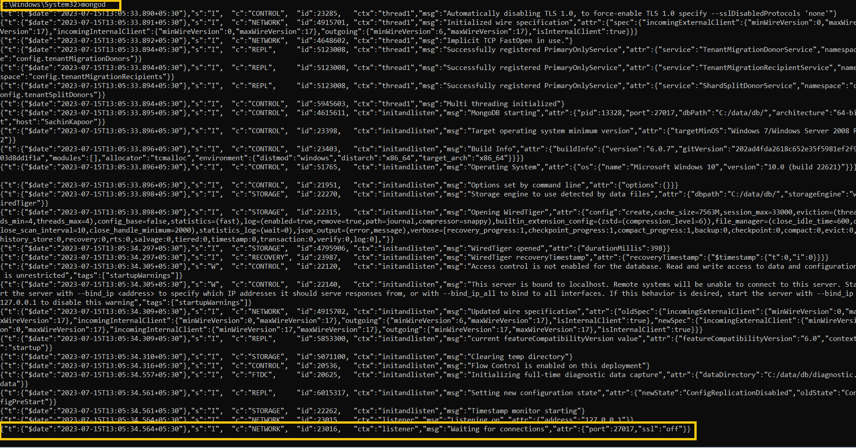
Running mongod command

Slide 41
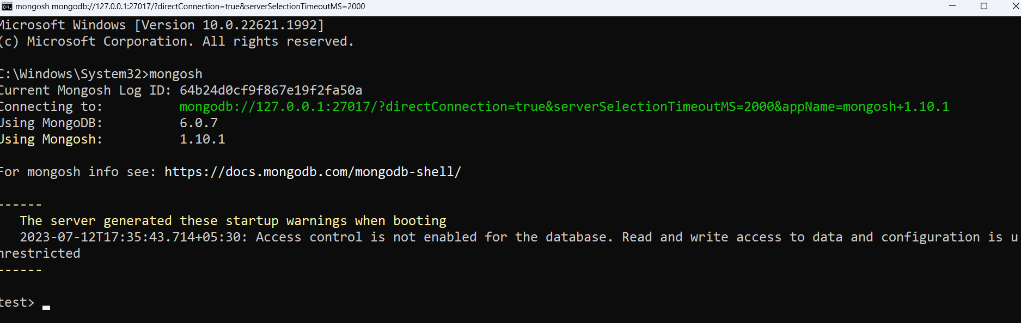
Running mongsh command

Slide 42
testing
To test if everything is OK or not just run the following command on the Mongo Shell:
show dbs;
It should display all the databases on the connected server.

Slide 43
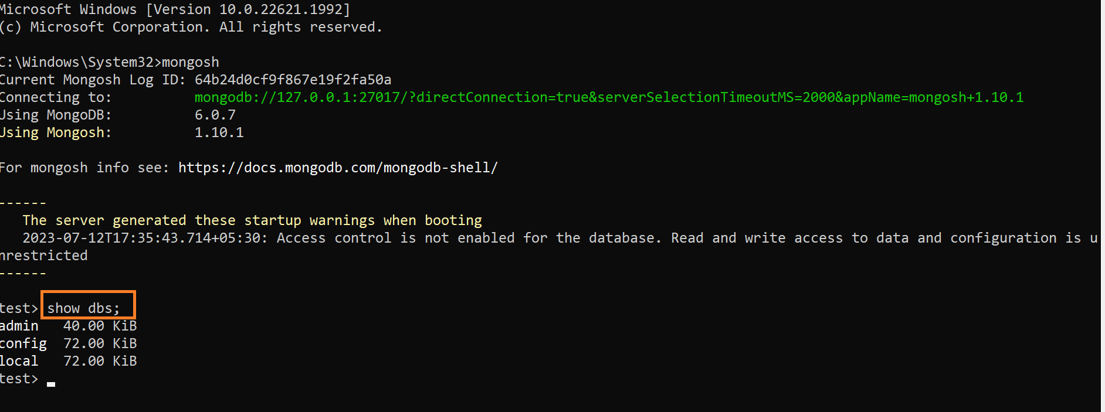
testing

